Slide 1
ROBOT APPLICATION IN MANUFACTURING
24ETC15E
By S Nithya Poornima,
Assistant Professor
MED, BMSIT &M

Slide 2
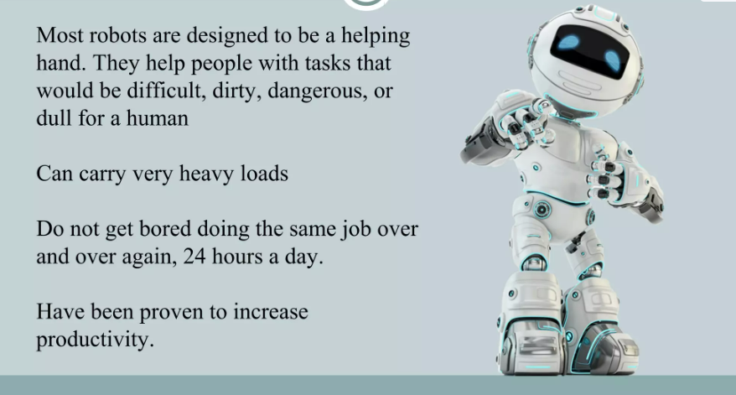

Slide 3
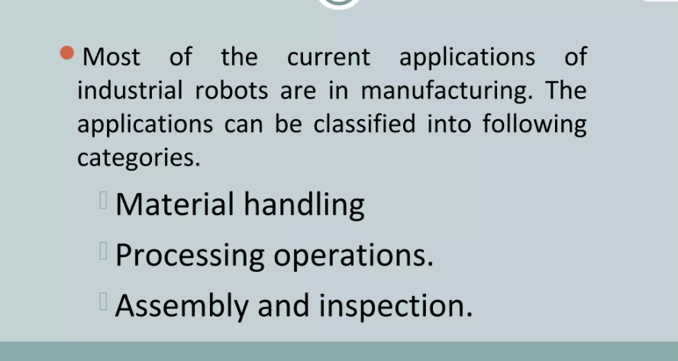

Slide 4
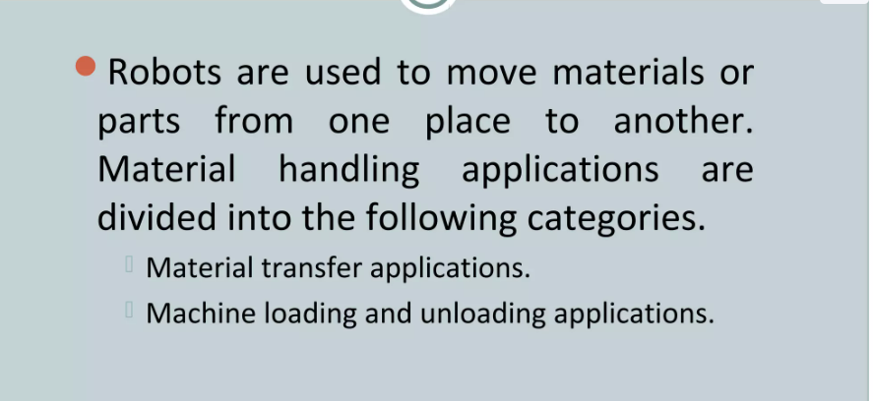

Slide 5
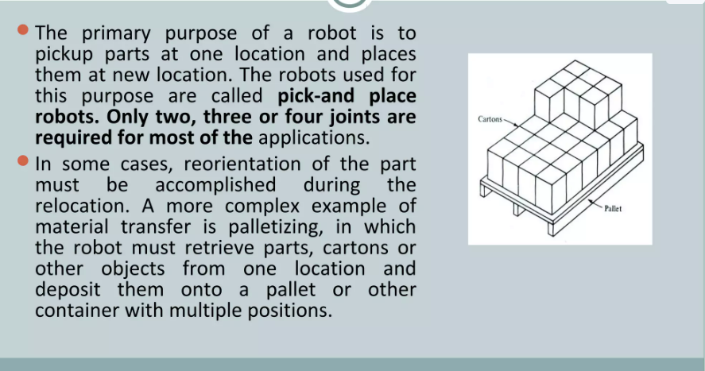

Slide 6
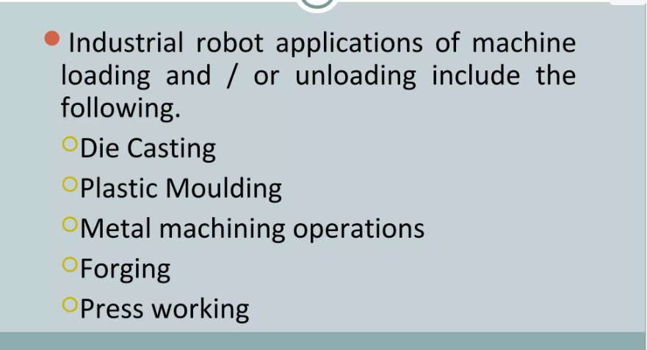

Slide 7
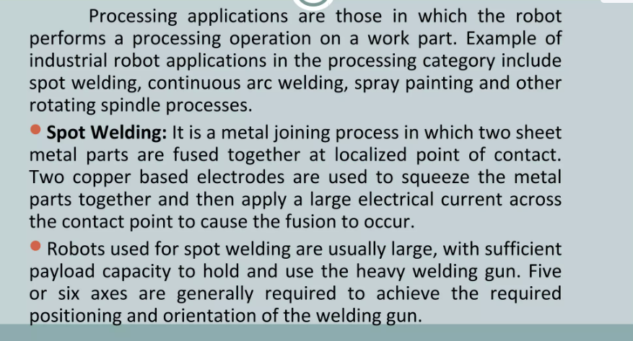

Slide 8
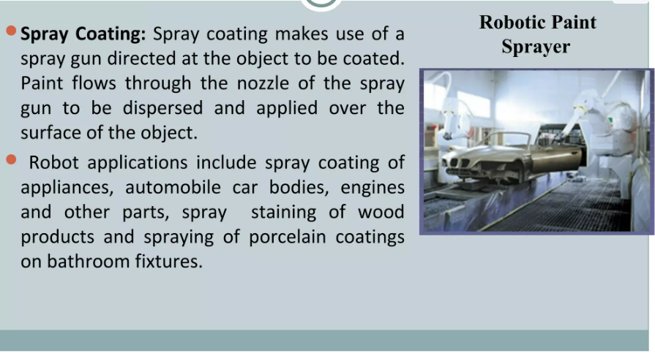

Slide 9
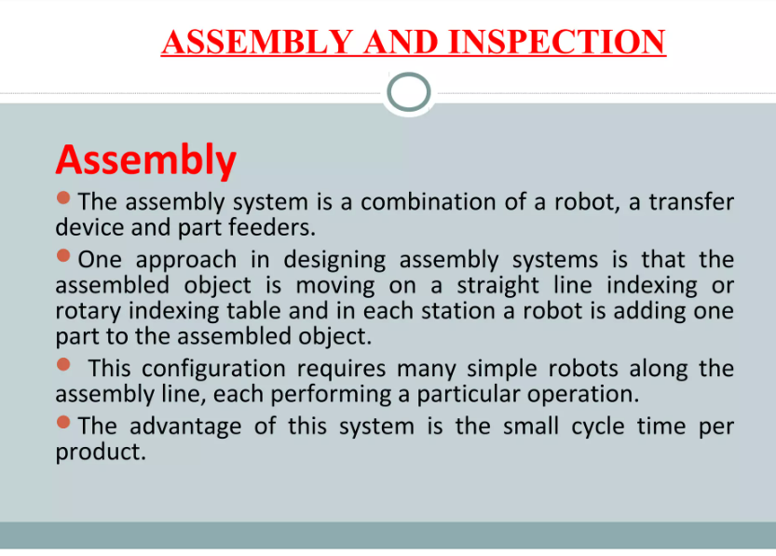

Slide 10
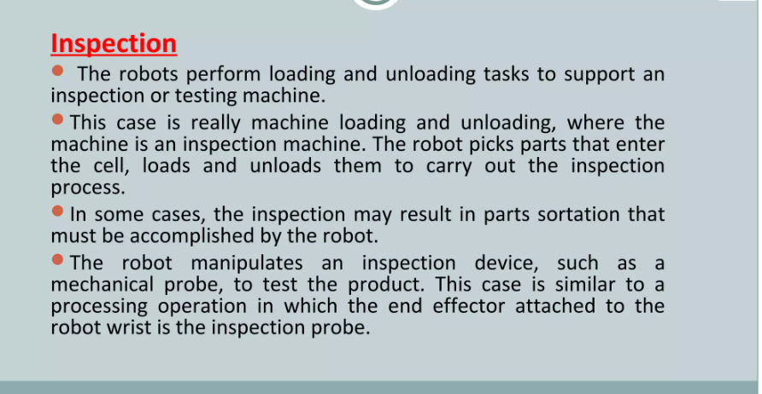

Slide 11
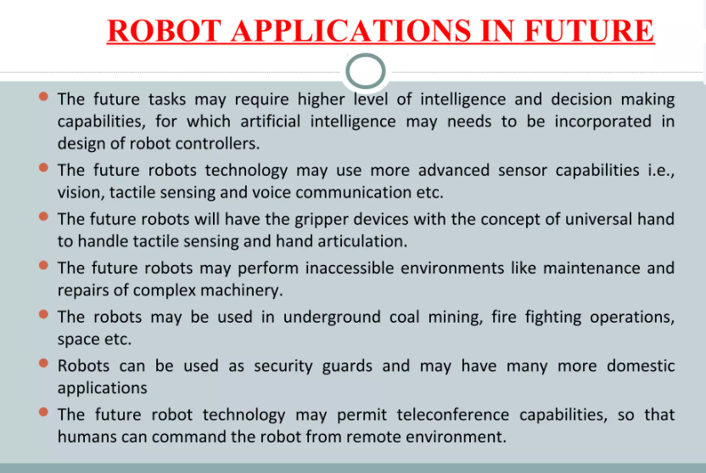

Slide 12

This Photo by Unknown Author is licensed under CC BY-SA

